Slide 1
The parental leave in Luxembourg
Myriam SCHANCK
President
National Fund for Family Allowances (CAE)
IEN Technical Seminar: Declining birth rates in Europe ‒ Social security challenges and responses
28–29 April 2026 | Valletta, Malta

Slide 2
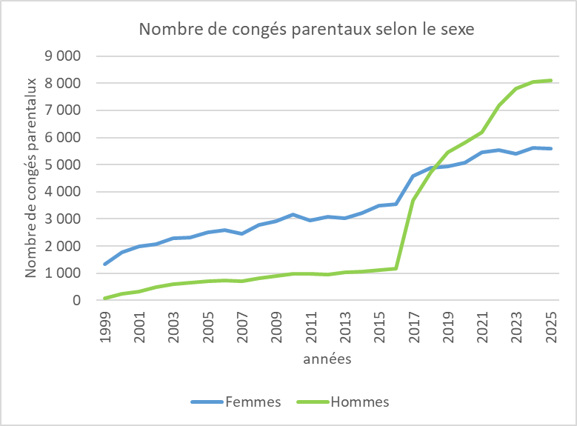
Success story

Slide 3
Impact: Father’s Take-up Rate
Significant increase in male participation since the reform
2024 : over 58% of beneficiaries are fathers
Normalizing shared parenting in the corporate world

Slide 4
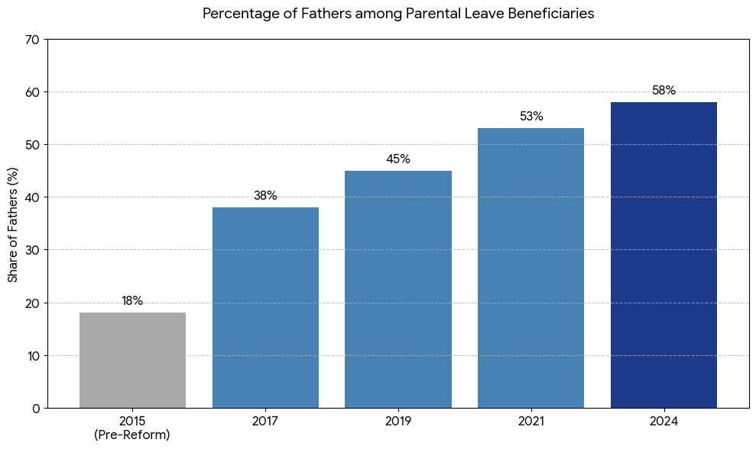
Impact: Father’s Take-up Rate

Slide 5
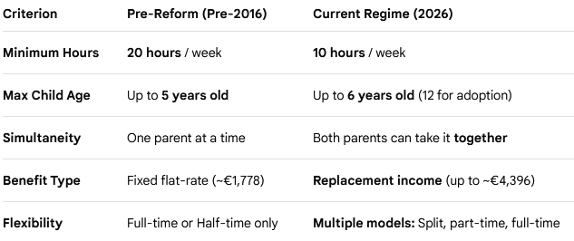
The “2016 - Turning Points”

Slide 6
The Four Flexible Models
Full-time: 4 or 6 months
Part-time: 8 or 12 months (50%)
Split: 4 single months within 20 months
Day-based: 1 day per week for 20 months

Slide 7
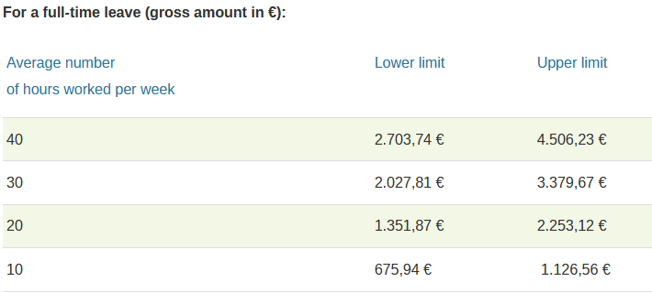
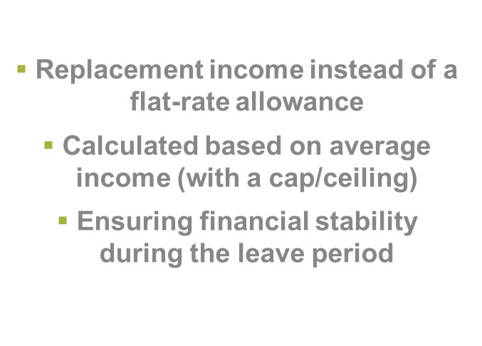
Financial Compensation

Slide 8
Conclusion & Outlook
Success depends on the combination of leave, cash benefits and childcare
Social security must evolve with modern family structures
Next steps

Slide 9
Q & A

